Slide 1
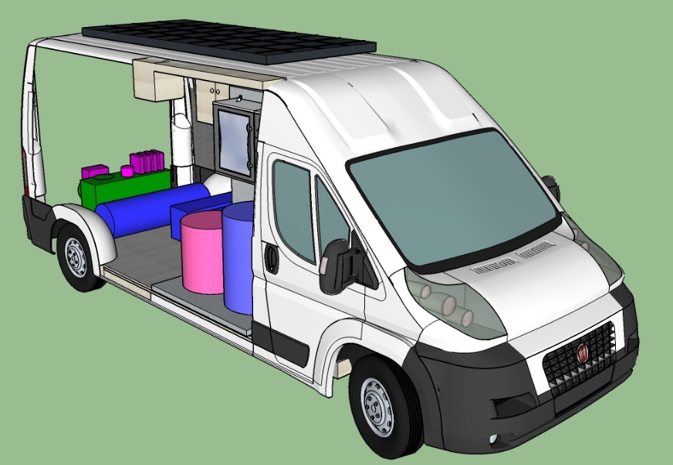
“Dew Water” Mobile Station

Slide 2
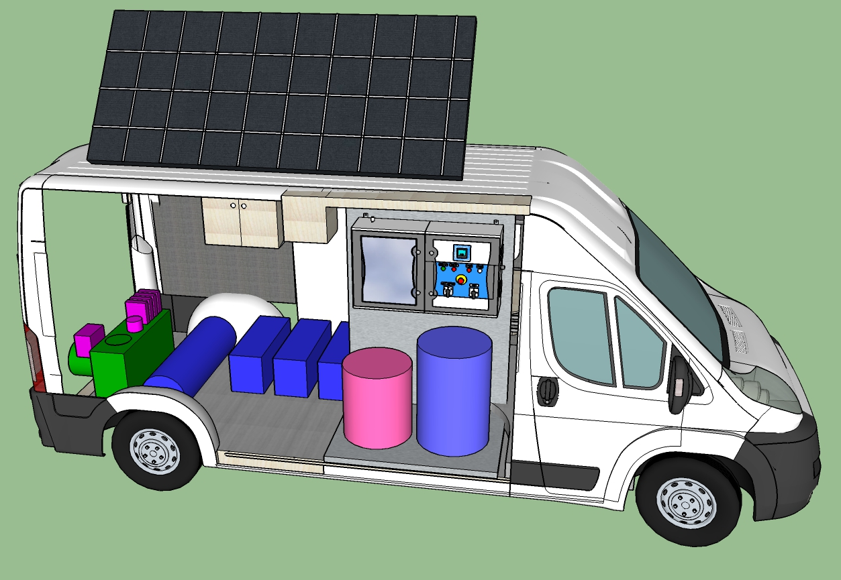
MOBILE STATION FOR WATER PRODUCTION AND SANITATION FOR PRIMARY USE
OF CIVIL PROTECTION
Group of water production from atmospheric air
Photovoltaic panel
with rainwater collection
ECA Anolyte Generator (ElectroChemical Activation)
Accumulation and supply tanks
Battery pack
Van system (or cart)

Slide 3
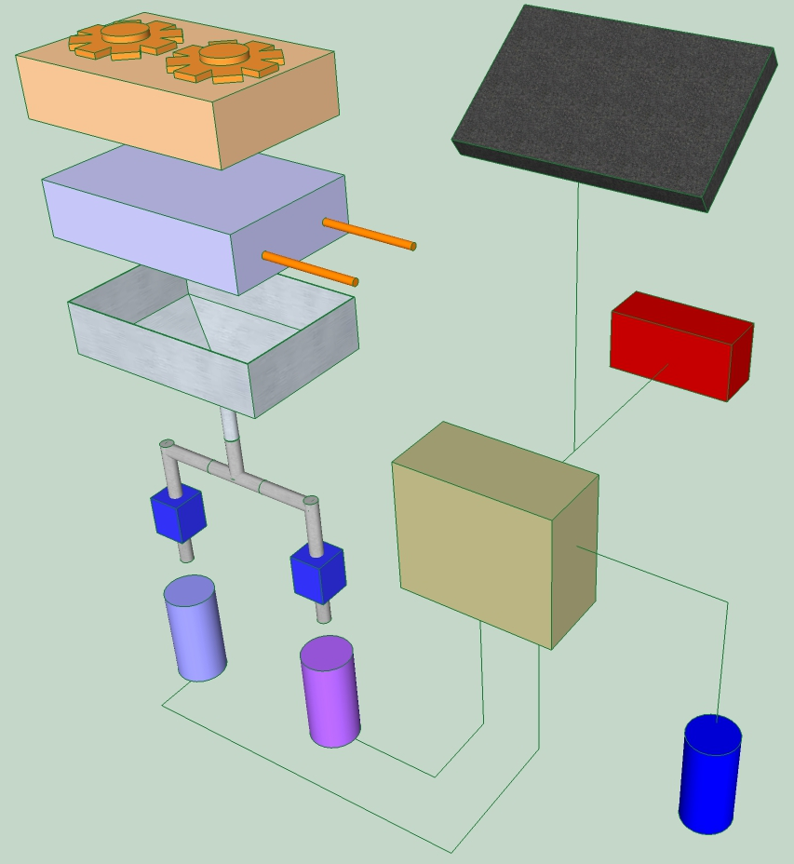
“Dew Water” Mobile station
1a Production unit of water from air
1b Evaporator unit with PCM fan / heat accumulator (Phase Change Material)
1a + 1b = Refrigeration unit
2 Condensed water collection system
3 Connection piping
4 Solenoid valve
5 Clean water tank
6 Saturated saline solution tank (brine)
7 ECA production system with electrolysis or with electrolytic cell
8 ECA tank
9 Electric storage unit / electric generator internal combustion means
10 Photovoltaic panel with rainwater collection channel
1a
10
1b
2
9
3
4
7
5
6
8

